Slide 1
FWA MLOps Accelerator
- Data: Synthetic eye disease claims from PCP in TX
A reusable framework for end-to-end model
development, deployment, monitoring, and retraining for
peer-provider comparisons.
Tanya (Tanying) Wang
Github repo:
https://github.com/tanyaw0923/GCP-FWA-MLOps-Accelerator/tree/main

Slide 2
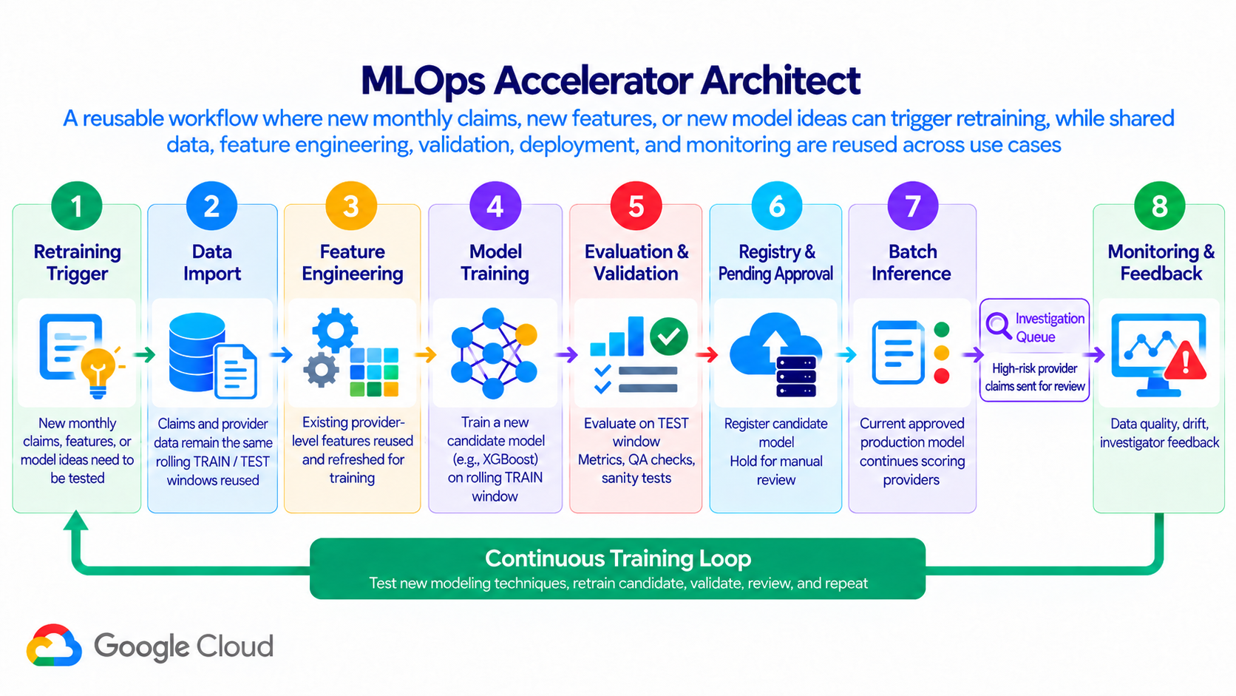

Slide 3
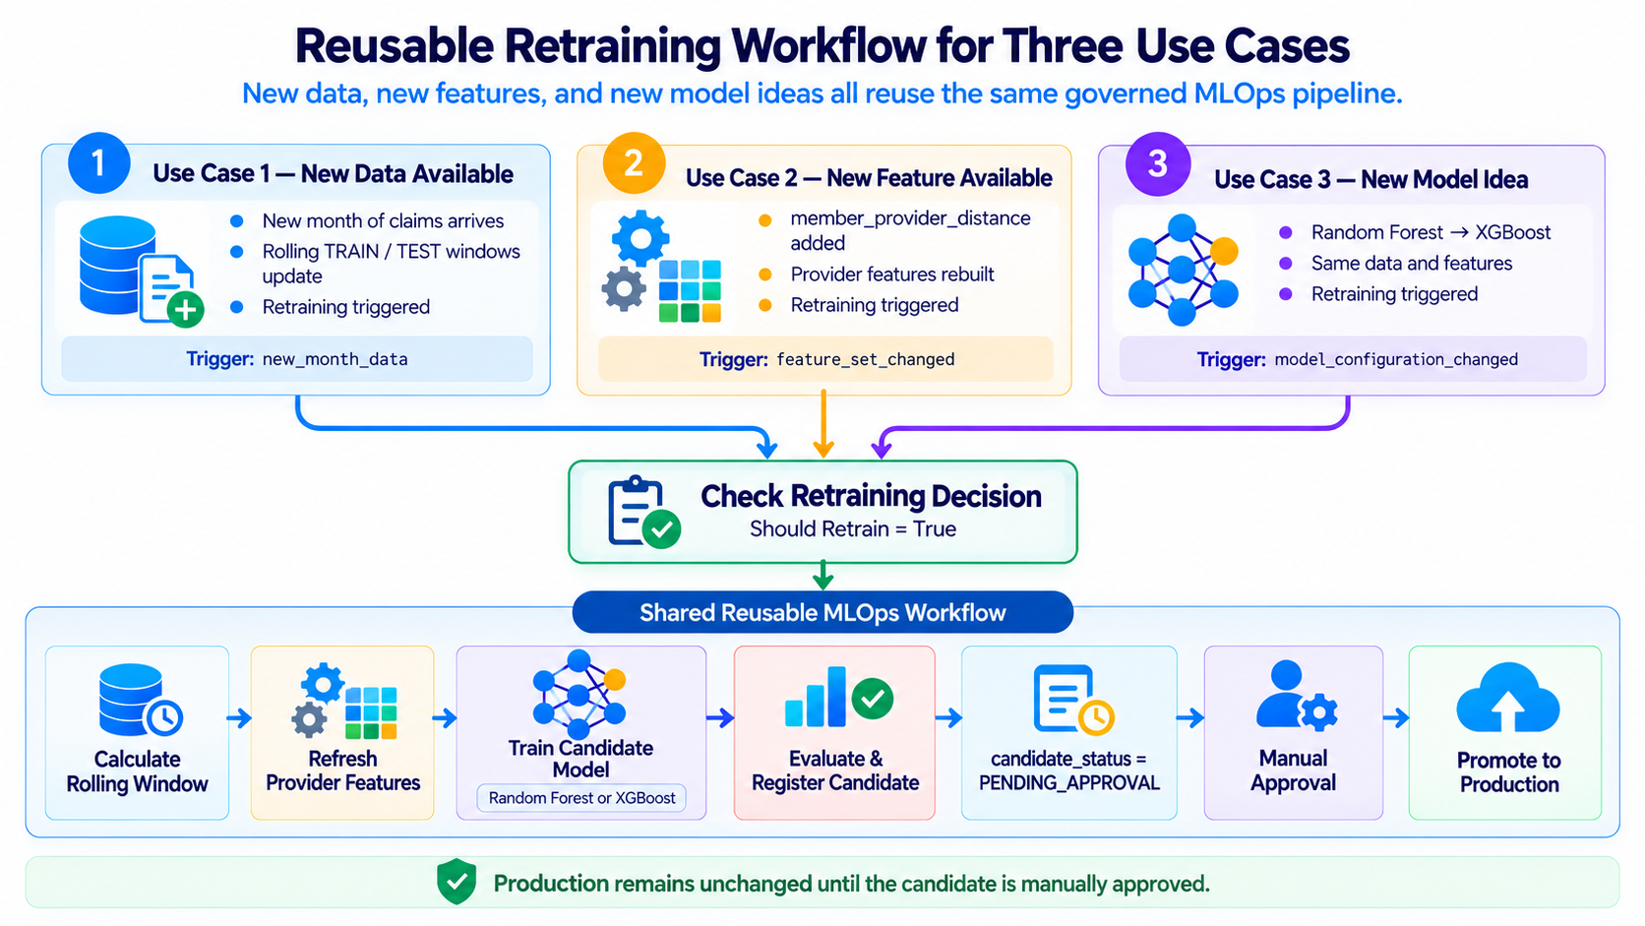

Slide 4
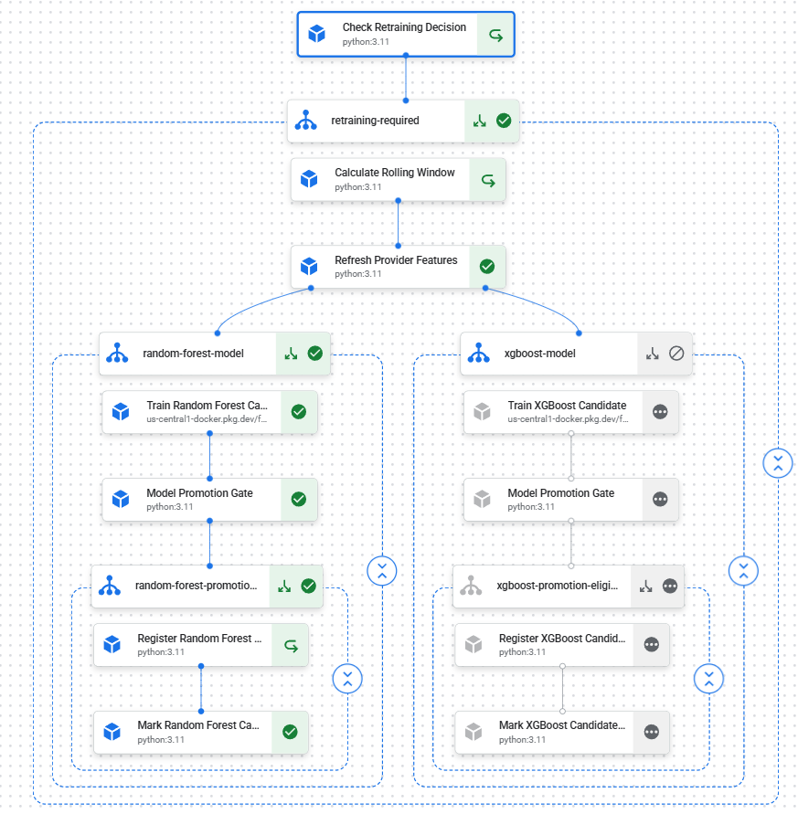
Data quality alert
OR
Feature drift alert
OR
Prediction drift alert
OR
Performance degradation alert
New monthly data
OR
Feature configuration changed
OR
Model configuration changed
↓
Should Retrain = True
Model Monitoring
Three Use Cases

Slide 5
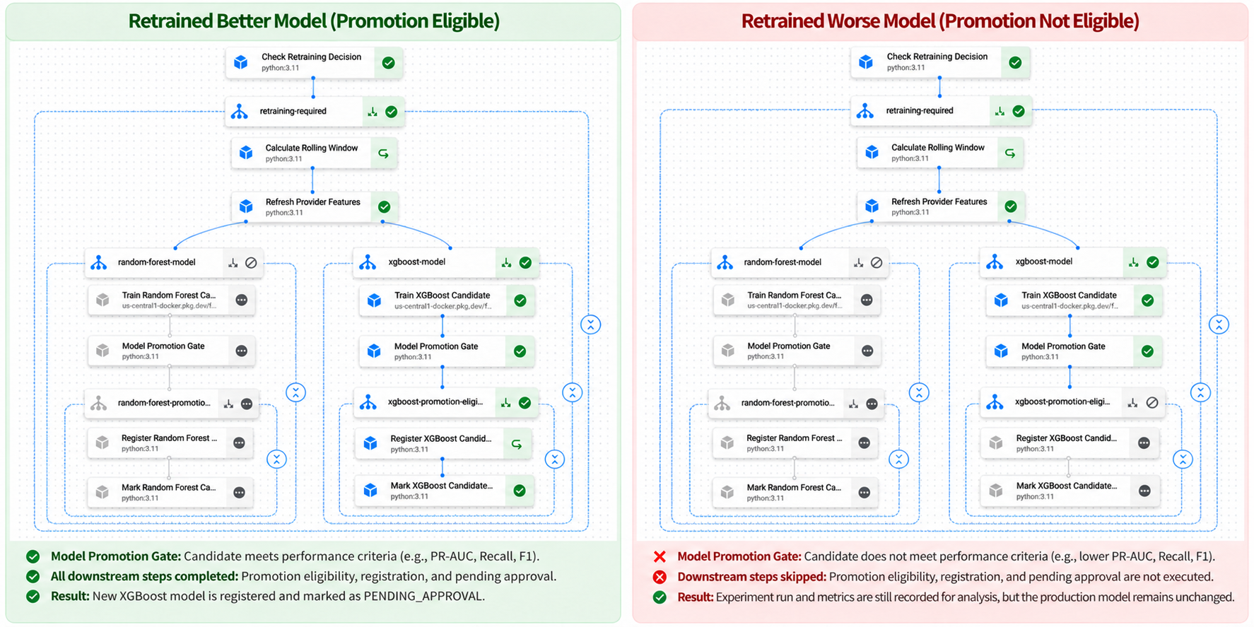

Slide 6
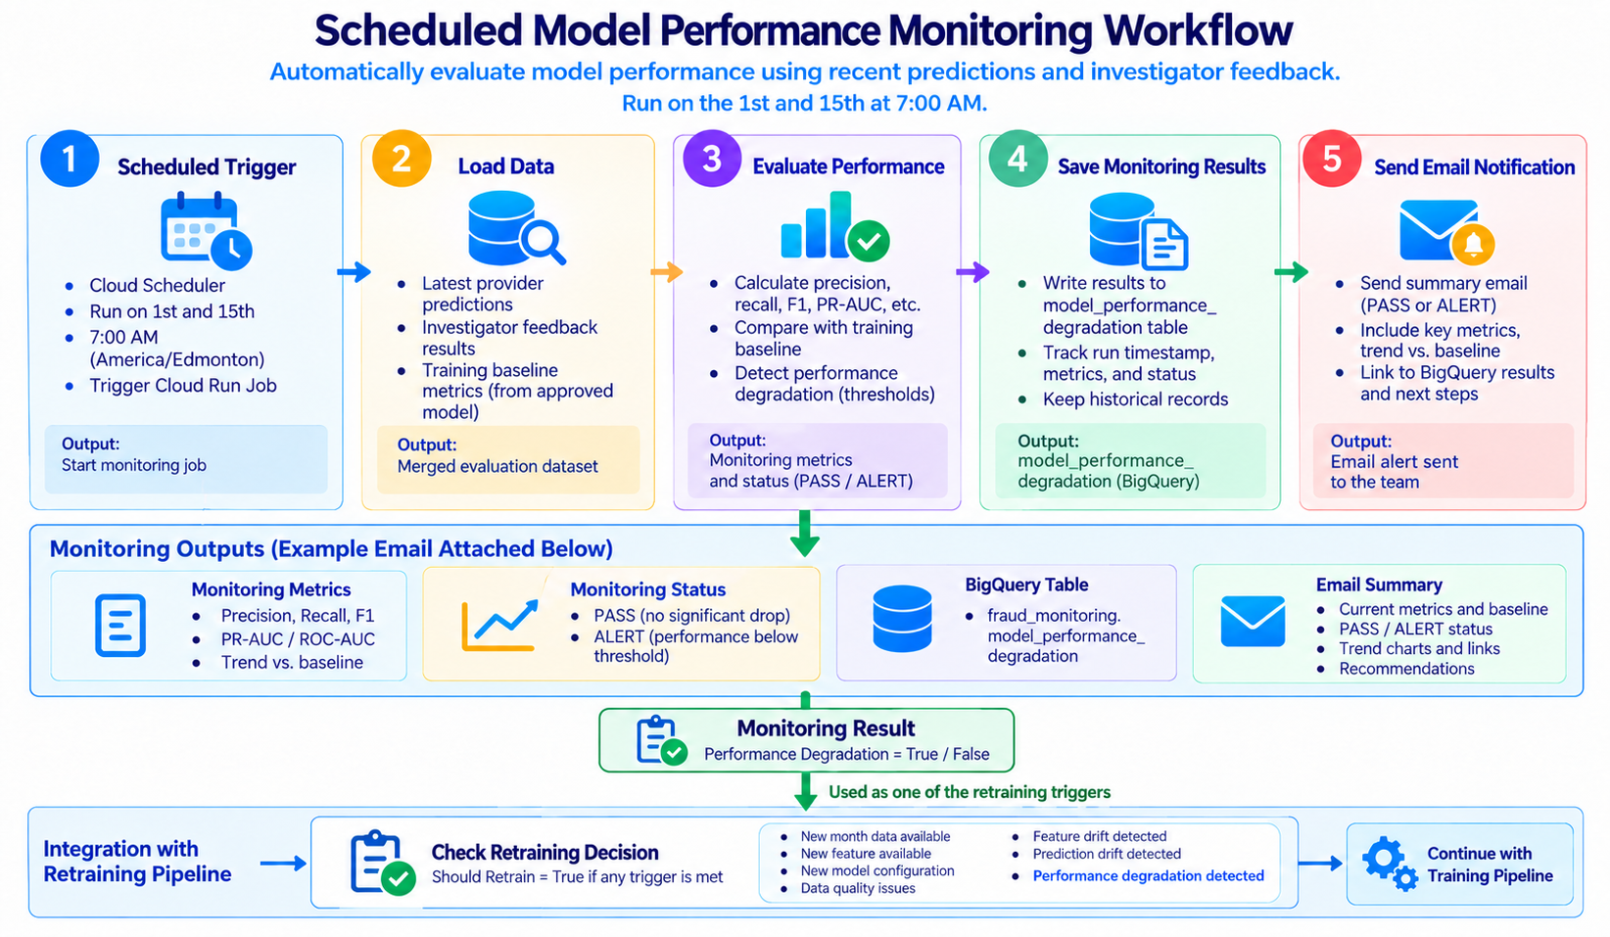

Slide 7
Thank you
Tanya (Tanying) Wang
Data Scientist / ML Engineer
Feedback: tanyaw0923@gmail.com

Slide 8
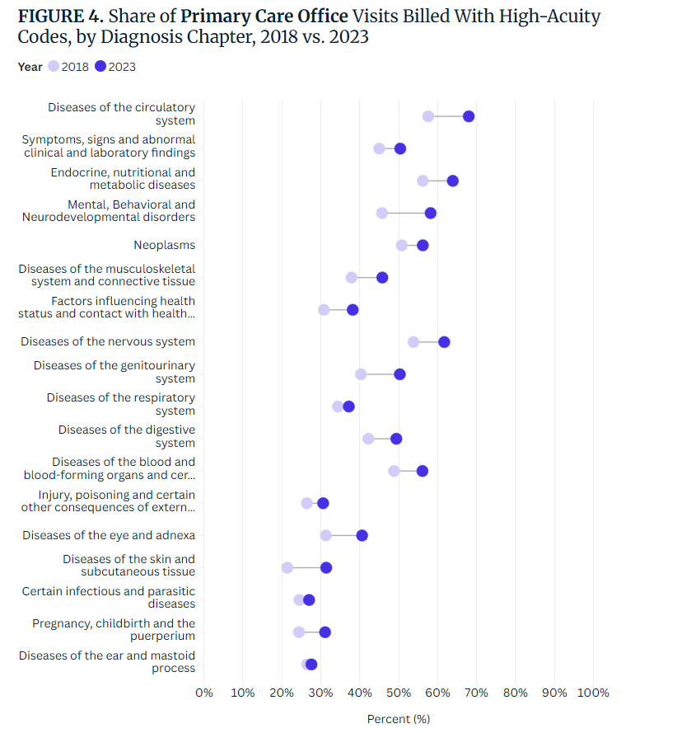
Reference
some of the other large increases are easier to reconcile with demographic change. Some don’t.
2018: 31%
2023: 40%
Change: +9 percentage points
Reference: https://www.trillianthealth.com/market-research/studies/changes-in-coding-intensity-suggest-upcoding

Slide 9
Training vs. production → Skew
Production over time → Drift
Feature values → Feature skew/drift
SHAP contributions → Feature attribution skew/drift

